Slide 1
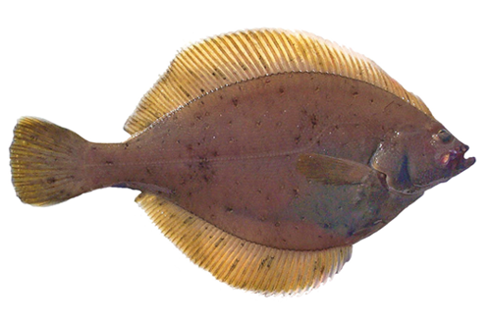
Assessment of the Yellowfin Sole Stock in the Bering Sea and Aleutian Islands
Ingrid Spies, Rebecca Haehn, Elizabeth Siddon, Jason Conner, Lyle Britt, Jim Ianelli

Slide 2
Plan Team and SSC Comments
SSC October 2020
The SSC agrees that sex-linked mortality is biologically plausible and concurs with the BSAI-GPT’s and authors’ recommendation to bring forward Model 18.2 (in addition to the 18.1 base model) for consideration in the next assessment.
Authors' response: We have included Model 18.1 and 18.2 in this assessment.
Plan Team September 2020
The Team recommends that, if the authors have time this year or else in the future, they should consider estimating male M freely but with female M adjusted so that the average across sexes is equal to 0.12
Authors' response: We have included Model 18.1 and 18.2 in this assessment. Further changes to female vs. male natural mortality will be explored in future models.

Slide 3
Plan Team and SSC Comments
SSC December 2019
The SSC suggests the application of the VAST model to estimate the proportion of Yellowfin Sole in the NBS over time, as well as an examination of other available data sources, in particular the ADF&G survey in Norton Sound that has been conducted triennially since 1978 and annually since 2017. The SSC continues to encourage the authors to consider approaches for including the substantial biomass of NBS Yellowfin Sole in the model, with the expectation that NBS surveys will be conducted regularly in the future.
Authors' response: Two models in the current assessment incorporate VAST estimates, one for the EBS (18.3) and one for the EBS+NBS (18.4). Data from the ADF&G survey are presented in this assessment.

Slide 4
Plan Team and SSC Comments
SSC December 2019
The SSC suggests the authors consider estimating a single selectivity curve for both sexes since the sex-specific selectivities are so similar.
Authors' response: This will be explored in a future year.

Slide 5
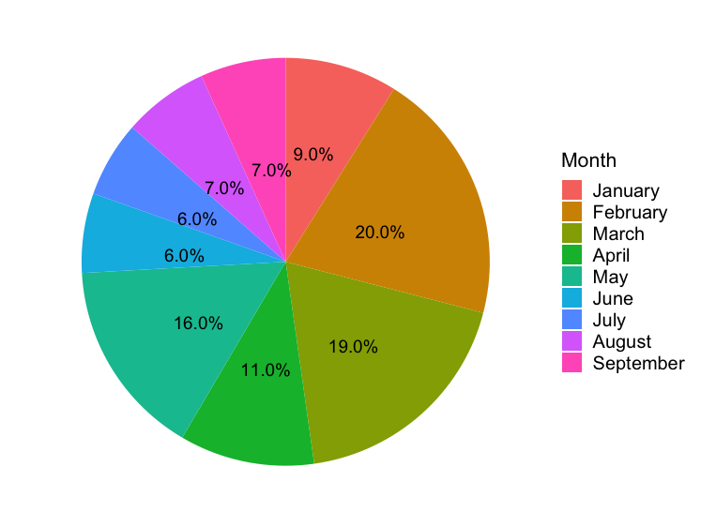
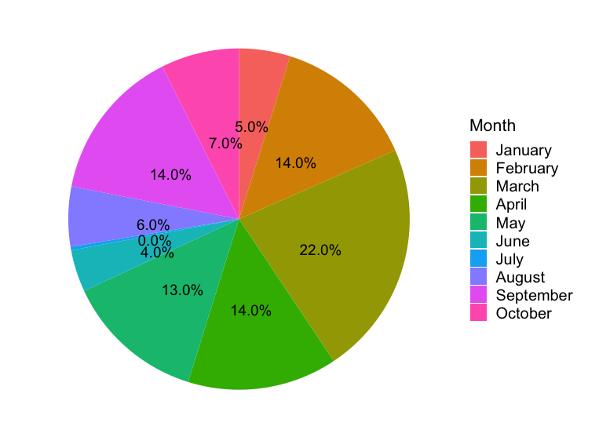
Catch in 2020 was very limited in July
2019
2020

Slide 6
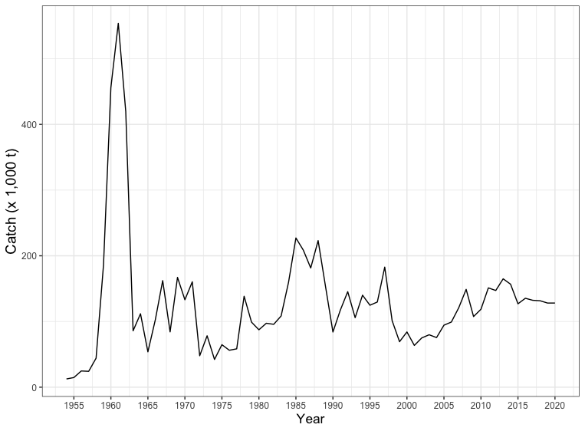
Catch was not low in 2020
Catch through
November 15, 2020

Slide 7
Trawl catch in 2020 by month

Slide 8
Trawl catch 2001-2020

Slide 9
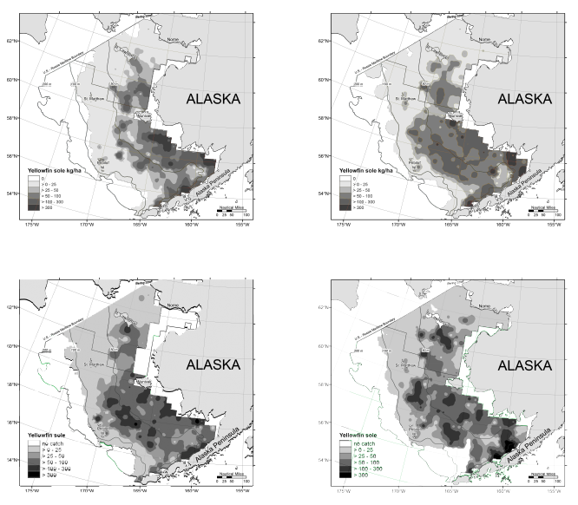
Are Yellowfin Sole moving northward?
2010
2017
2018
2019

Slide 10
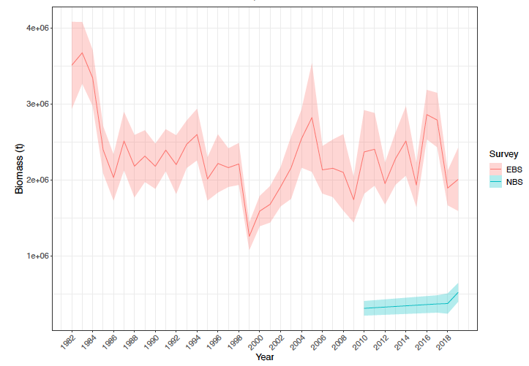
Annual EBS and NBS bottom trawl survey biomass and 95% CI’s for Yellowfin Sole, 1982--2019

Slide 11
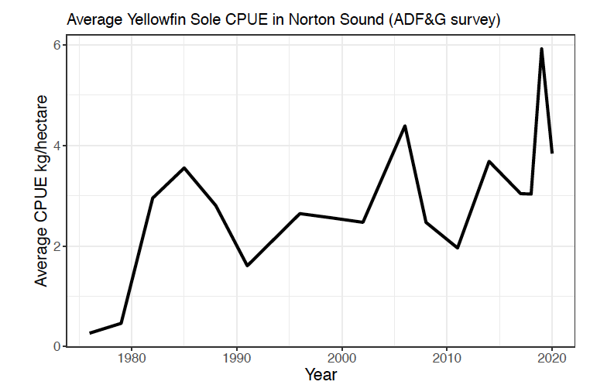
CPUE appears to be gradually increasing in Norton Sound

Slide 12
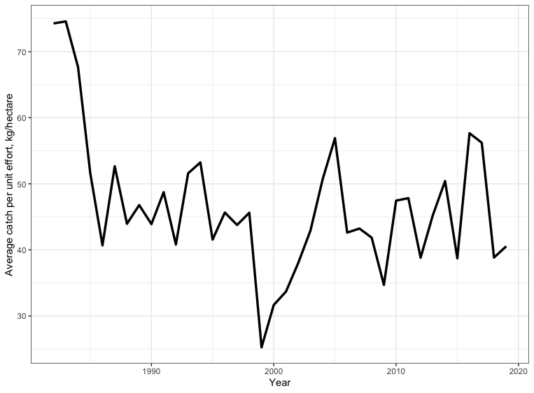
Average catch per unit effort on NMFS eastern Bering Sea surveys, 1982-2019.

Slide 13
Models
Model 18.1
The accepted 2019 Model 18.1 included the survey mean bottom temperature across stations < 100m as a covariate on survey catchability, as in previous years, but added survey start date as an additional covariate (Nichol et al. 2019).
Model 18.2
Female natural mortality (M) is fixed at 0.12 while allowing the model to estimate male M. This model retains the features of Model 18.1.

Slide 14
Models
Model 18.3
Same as Model 18.2 but includes VAST estimates for Eastern Bering Sea biomass and error.
Model 18.4
Same as Model 18.2 but includes VAST estimates for Eastern Bering Sea plus Northern Bering Sea biomass and error.

Slide 15
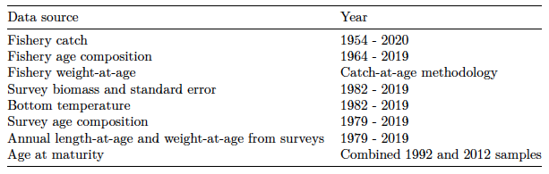
Data included in the model
Estimates of fishery weight-at-age was based on catch-at-age methodology used in the Walleye Pollock assessment (Ianelli et al. 2019), following Kimura (1989) and modified by Dorn (1992).

Slide 16
Selectivity
Two parameter formulation of the logistic function.
Used for fishery and survey.
Modeled separately for males and females.
Modeled annually for the fishery.

Slide 17
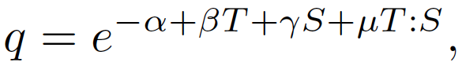
Catchability
Included survey start date and bottom temperature as follows:
where T=survey bottom temperature at survey stations less than 100 m (averaged per year for all stations <100 m), S=survey start date, and T:S=interaction of T and S.
The result of incorporating bottom temperature and survey start date have resulted in an improved fit to the survey.

Slide 18
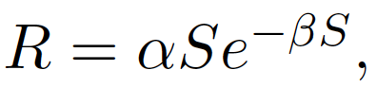
Spawner-Recruit Estimation
Annual recruitment estimates from 1978-2014 were constrained to fit a Ricker (1958) stock recruitment relationship:
where R is age 1 recruitment, S is female spawning biomass in metric tons the previous year, and α and β are parameters estimated by the model.

Slide 19
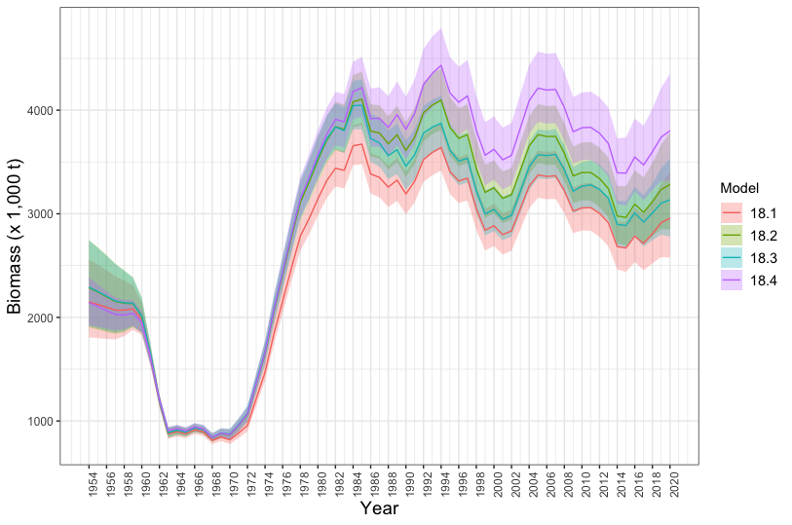
Model estimates of total (age 2+) biomass with 95% confidence intervals

Slide 20
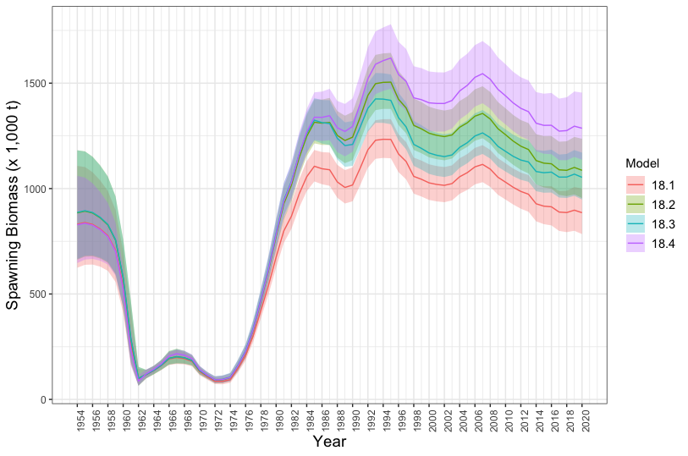
Model estimates of female spawning biomass with 95% confidence intervals

Slide 21
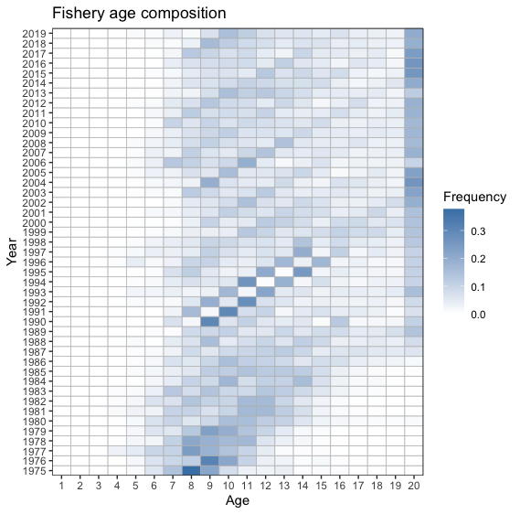
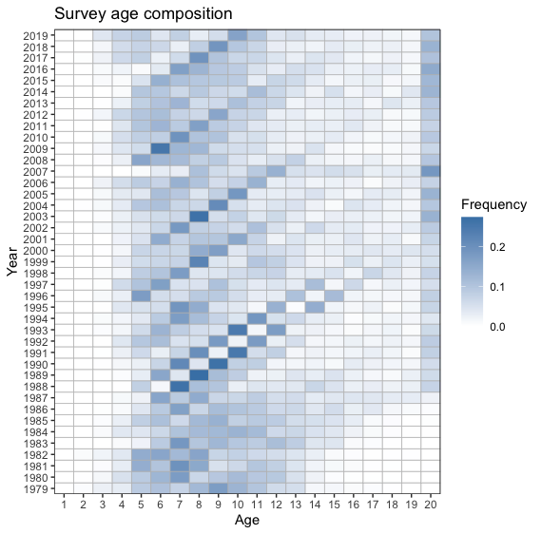
Fishery and survey age classes
2010 Year class
2004 Year class
1996 Year class

Slide 22
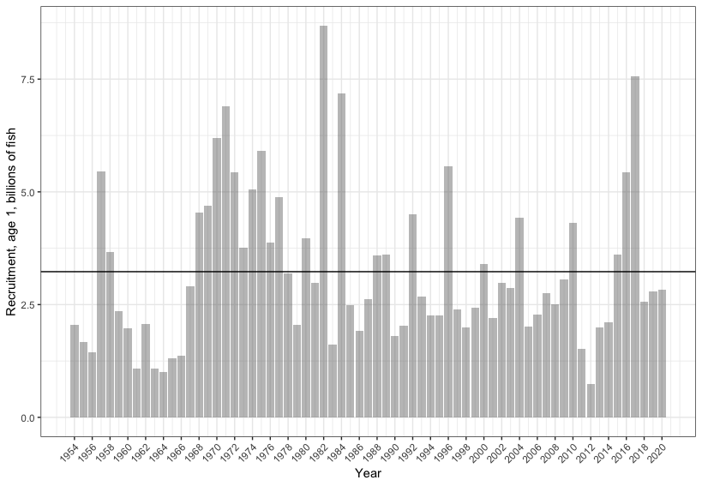
Age 1 recruitment (Model 18.2)

Slide 23
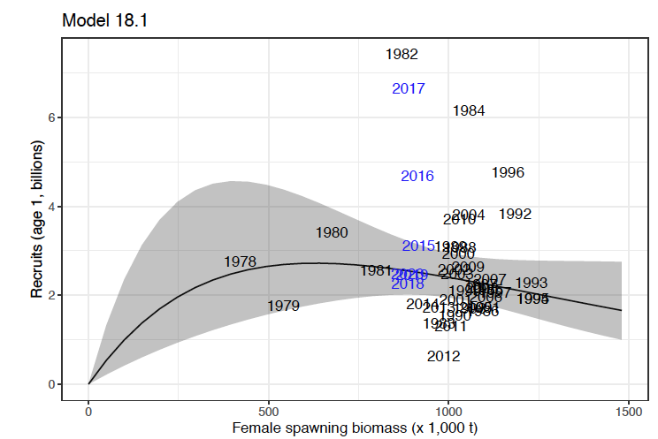
Ricker S-R curve, 95% CIs fit to FSB (years in black) and recruitment 1978-2014, Model 18.1

Slide 24
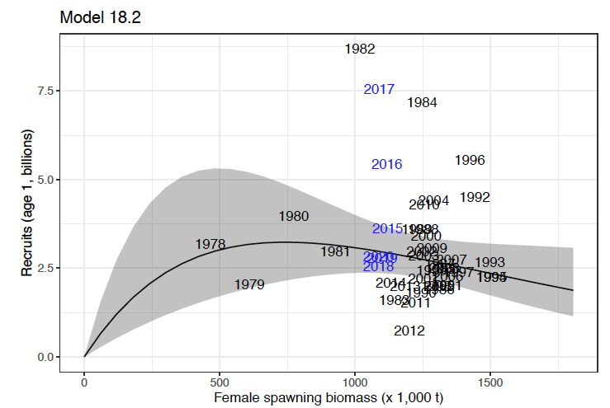
Ricker S-R curve, 95% CIs fit to FSB (years in black) and recruitment 1978-2014, Model 18.2

Slide 25
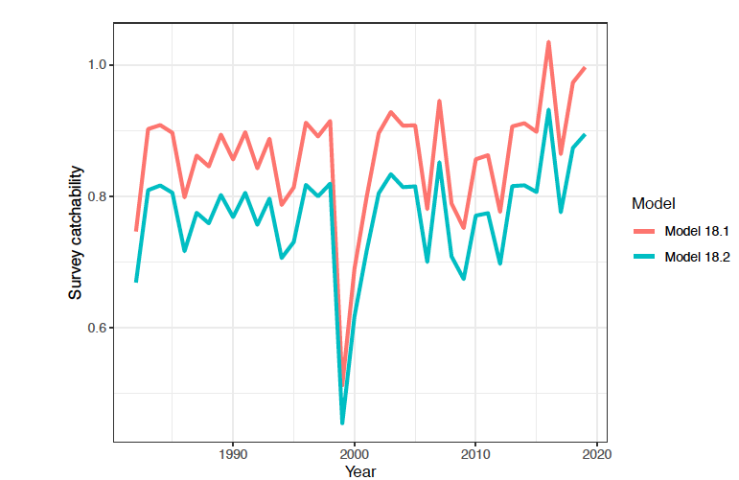
Survey catchability for Models 18.1 and 18.2, 1982-2020.

Slide 26
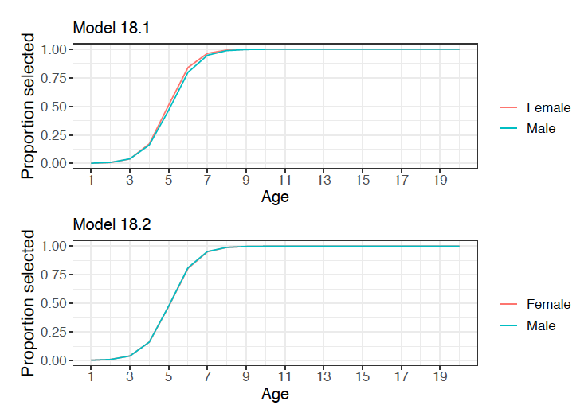
Survey selectivity

Slide 27
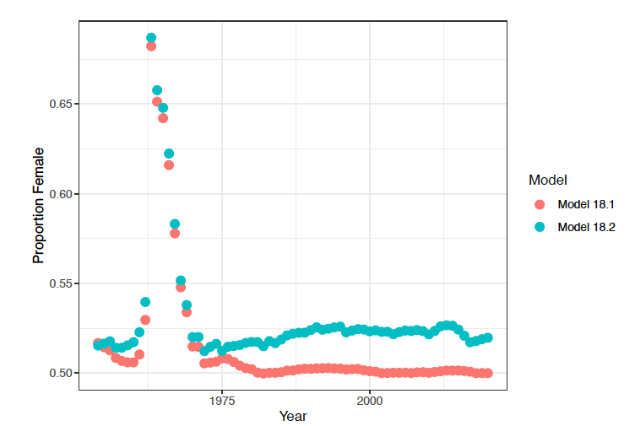
Model estimates of the proportion of female YFS in the population, 1982-2020

Slide 28
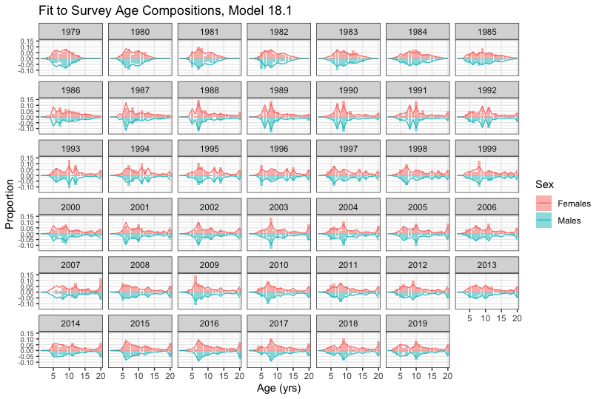
Model 18.1 fit to the time-series of survey age composition, by sex, 1979-2019

Slide 29
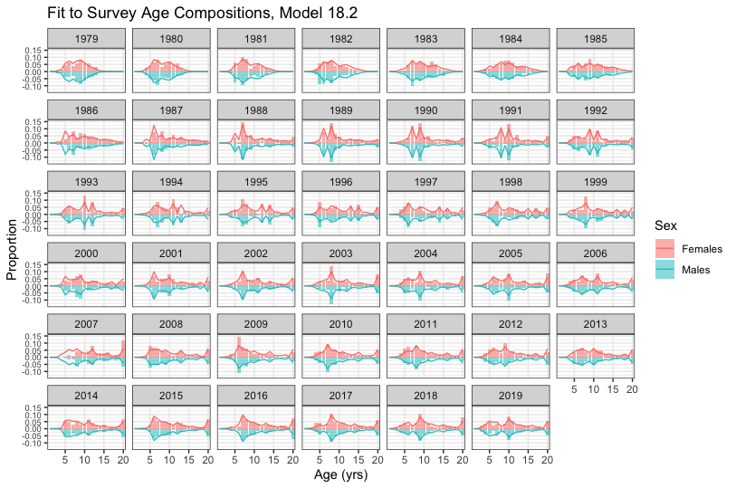
Model 18.2 fit to the time-series of survey age composition, by sex, 1979-2019

Slide 30
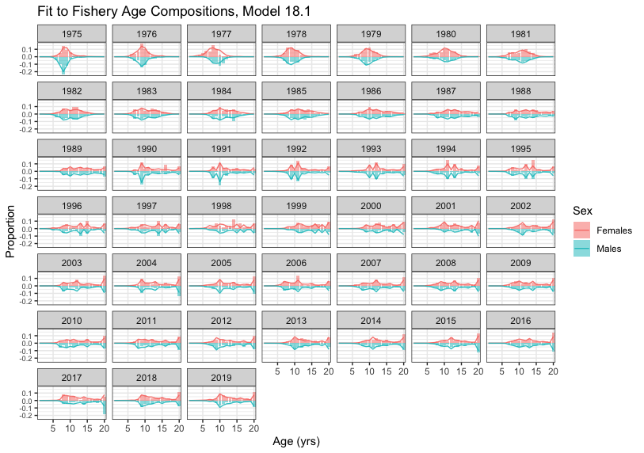
Model 18.1 fit to the time-series of fishery age composition, by sex

Slide 31
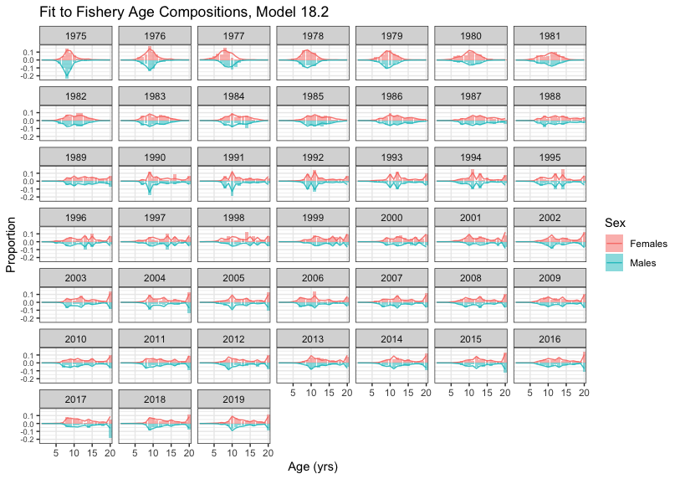
Model 18.2 fit to the time-series of fishery age composition, by sex

Slide 32
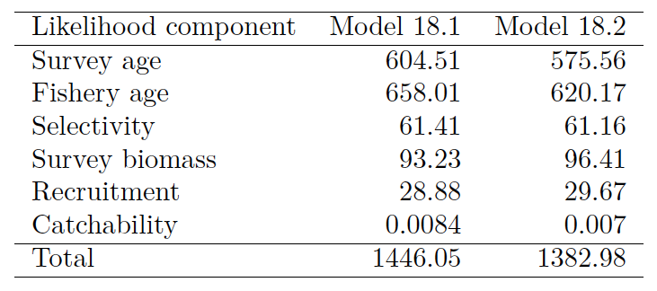
Comparison of likelihood values for Models 18.1 and 18.2.

Slide 33
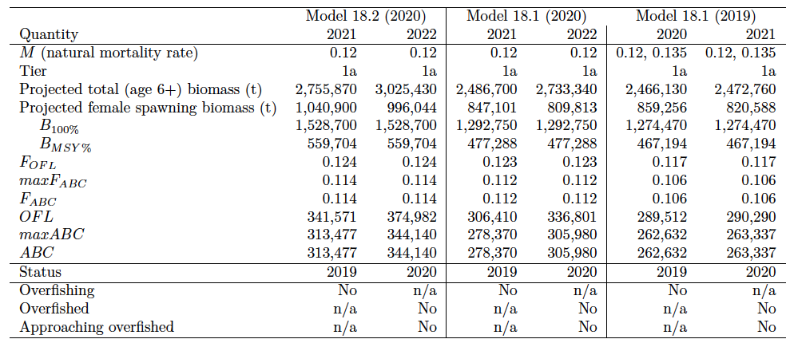
Comparison of reference points for Models 18.1 and 18.2

Slide 34
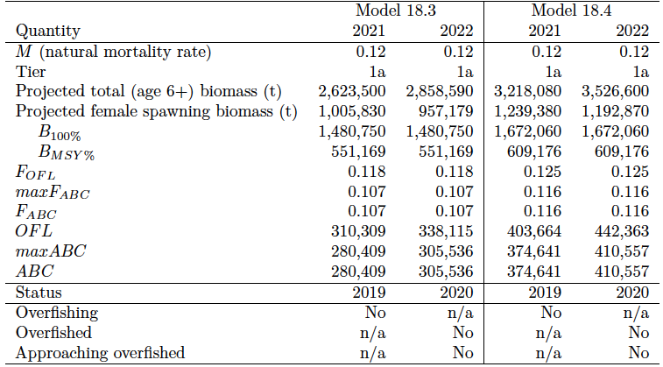
Comparison of reference points for Models 18.3 and 18.4

Slide 35
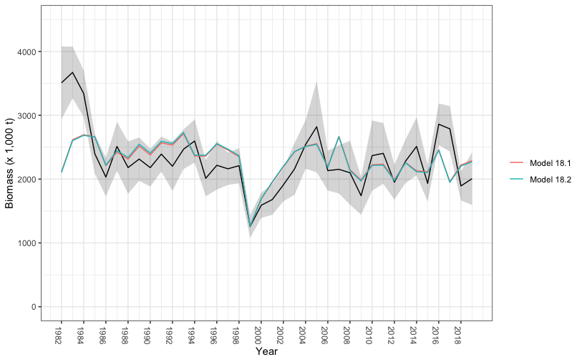
NMFS EBS survey biomass fit to survey data, Models 18.1, 18.2, 1982-2019

Slide 36
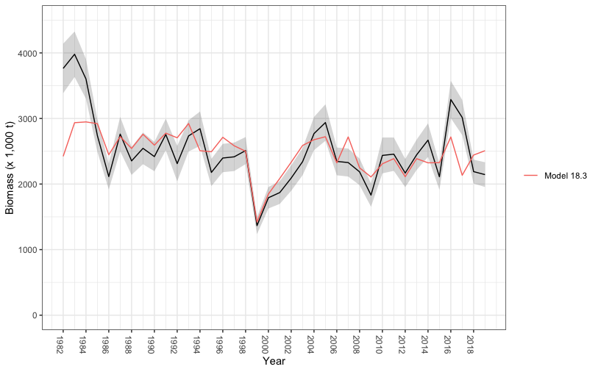
NMFS EBS survey biomass fit to survey data, Model 18.3, 1982-2019

Slide 37
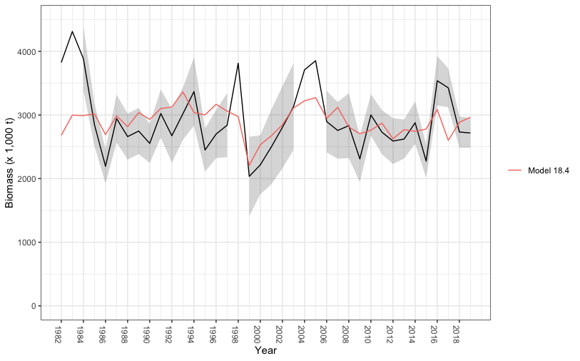
VAST NBS+EBS survey biomass fit to survey data, Model 18.4, 1982-2019

Slide 38
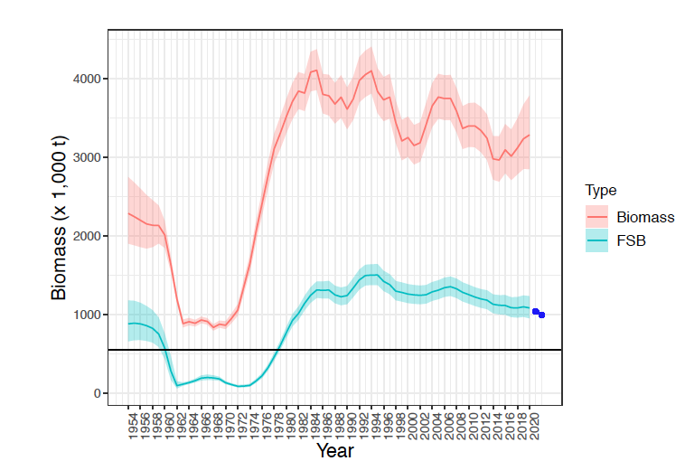
Model 18.2 estimates of total and female spawning biomass with 95% confidence intervals, 1954-2020.
Model projections of
female spawning biomass
for 2021 and 2022.
B_{MSY}

Slide 39
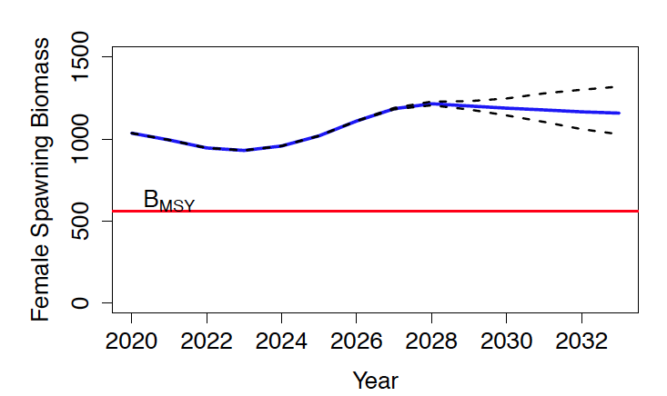
Projected female spawning biomass for 2020-2033 (blue line), and fishing at the 2015-2019 average.

Slide 40
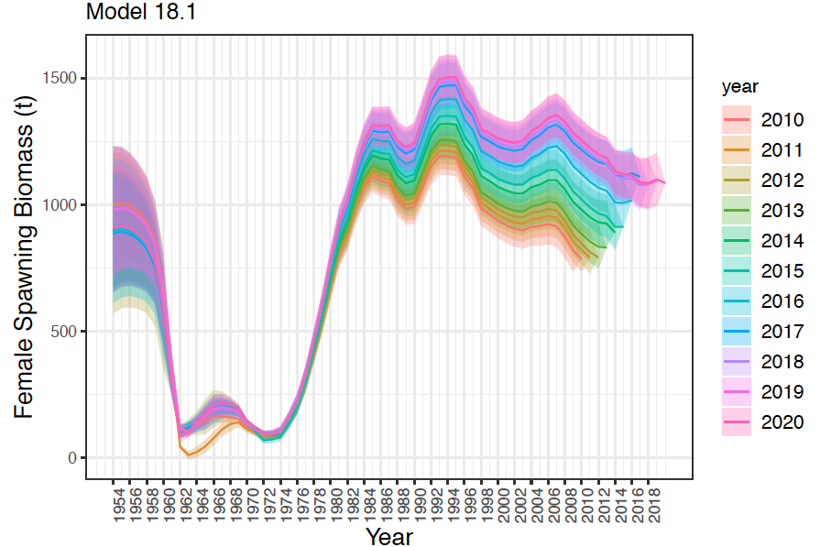
Model 18.1 retrospective plot of FSB, sequentially removed through 2010.

Slide 41
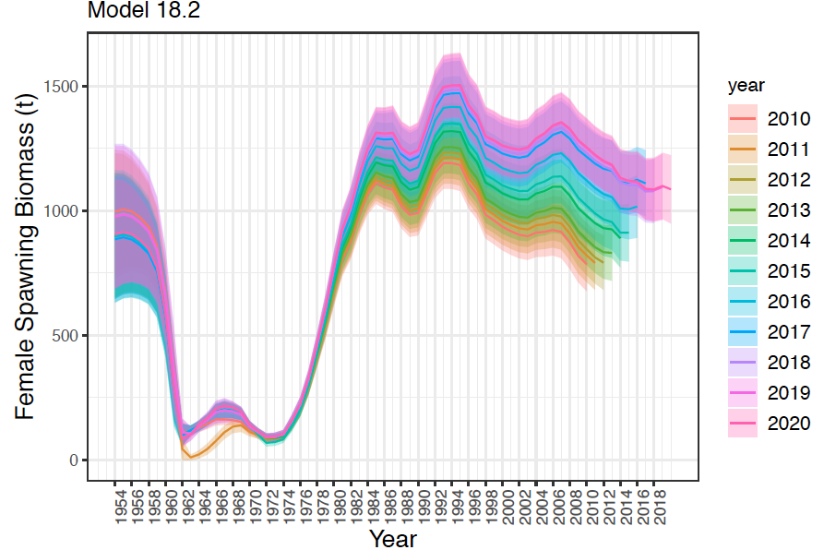
Model 18.2 retrospective plot of FSB, sequentially removed through 2010.

Slide 42
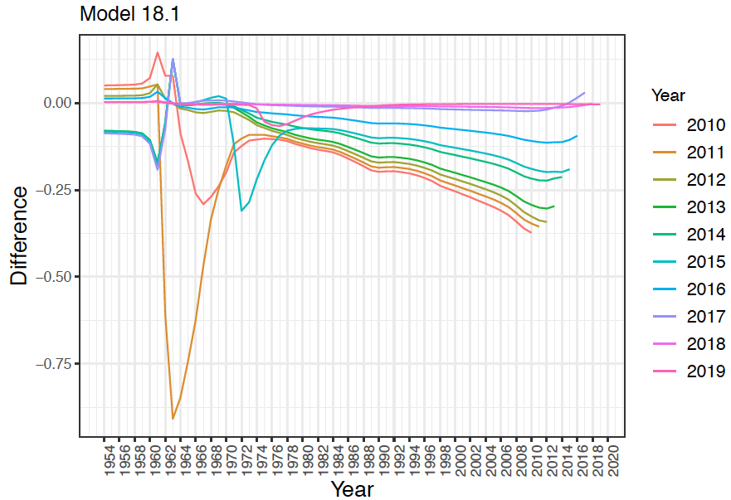
Model 18.1 retrospective plot of female spawning biomass, data sequentially removed through 2010.

Slide 43
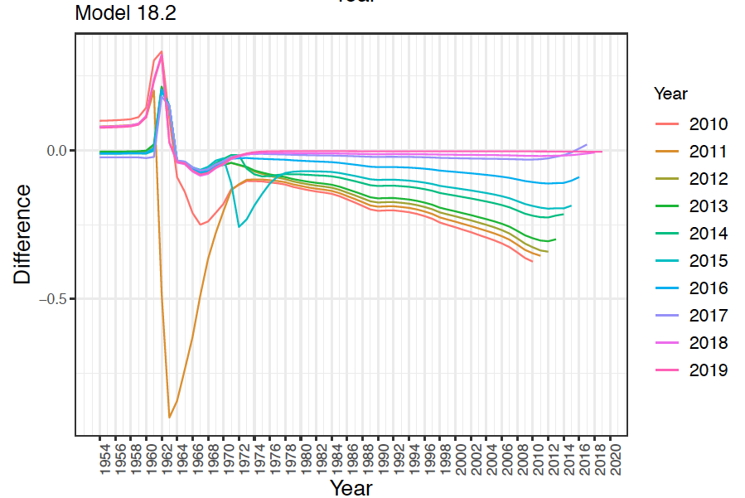
Model 18.2 retrospective plot of female spawning biomass, data sequentially removed through 2010.

Slide 44
Uncertainty Assessment (Bryan et al. 2020)
The BSAI yellowfin sole exhibited a negative bias that became more negative when the most recent survey data were not included in the assessment model (-.209 with survey to -.0.237 without survey).
Bias in recruitment was greater for EBS Pacific cod, tanner crab and snow crab and less for BSAI yellowfin, northern rock sole, flathead sole, and Greenland turbot when the most recent survey data was missing from the assessment model.
Based on this analysis, level of uncertainty in the Yellowfin Sole stock is lower than for other species.

Slide 45
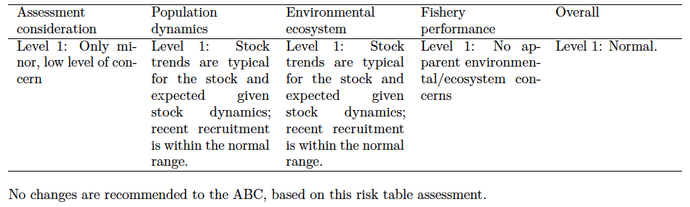
Risk Table

Slide 46
Risk Table – Assessment Related Considerations
The BSAI Yellowfin Sole assessment is based on surveys conducted annually on the EBS shelf from 1982-2019
Fish ages, derived from otoliths collected during the surveys and the fishery to calculate annual estimates of population and fishery age composition, have been validated.
The assessment model compositional and abundance data well and converges to a single minima in the likelihood surface.
Recruitment estimates track strong year-classes that are consistent with the data.
Assessment considerations are not a concern for this assessment.

Slide 47
Risk Table – Population Dynamics Considerations
The present biomass is estimated at 80% of the peak 1985 level and female spawning biomass is almost double B_{MSY}.
Projections indicate that the FSB will remain well-above the B_{MSY} level through 2033.
Population dynamics are not a concern for this assessment.

Slide 48
Environmental/Ecosystem Considerations
Summer bottom temperatures and spatial extent of the cold pool were average, indicating a cooler thermal experience for YFS, which may be adapted to colder temperatures.
In 2019, YFS condition (weighted length-weight residuals) was positive in the SEBS and NBS and continued upward trends since 2017;
The mean size of the groundfish community increased in 2019 buoyed by species including YFS, which had above average mean length;
Sufficient prey availability for YFS over the southern Bering Sea shelf;
Increase of predators over the eastern Bering Sea shelf indicates increased risk of predation, although size, spatial, and/or temporal mismatches may exist and provide refuge for YFS;
No apparent ecosystem concerns--level 1.

Slide 49
Fishery Performance Considerations
Fishery CPUE is not showing a contrasting pattern from the stock biomass trend, unusual spatial pattern of fishing, or changes in the percent of TAC taken, changes in the duration of fishery openings.
No apparent fishery performance considerations – level 1.

Slide 50
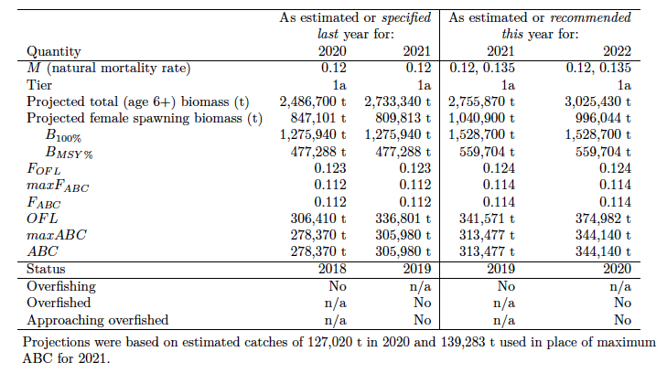
Summary Table

Slide 51
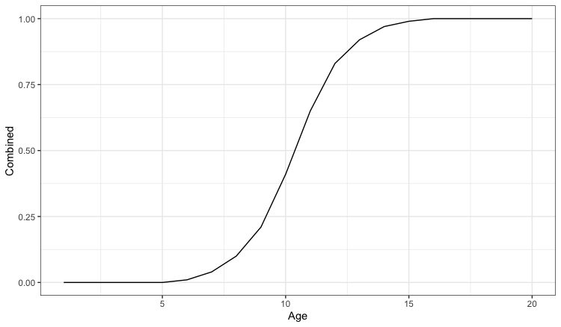
Maturity at age
Yellowfin sole maturity schedules were estimated from two studies.
Nichol (1995) and Wilderbuer (2015).

Slide 52
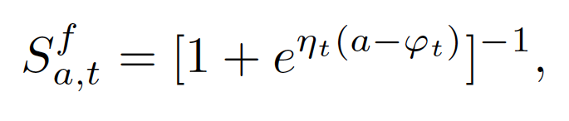
Fishery Selectivity
where a is age, t is year, and φ_{t} and η_{t} are time-varying and partitioned (for estimation) into parameters representing the mean and a vector of deviations (log-scale) conditioned to sum to zero. The deviations are constrained by a lognormal prior with a variance that was iteratively estimated. The process of iterating was to first set the variance to a high value to estimate the deviations. The next step was to compare the variability of model estimates. The variance of the model estimates were then rounded up slightly and fixed for subsequent runs. The 2020 values were fixed as the average of the 3 most recent years.

Slide 53
